Slide 1
Theory of Automata
Lecture # 9-10

Slide 2
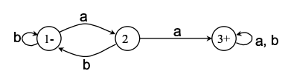
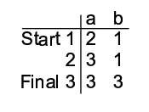
Transition Table

Slide 3
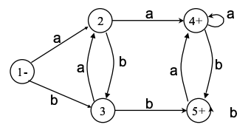
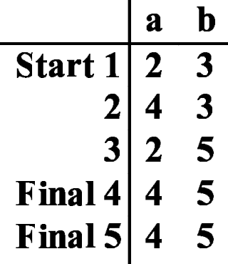
Transition Table

Slide 4
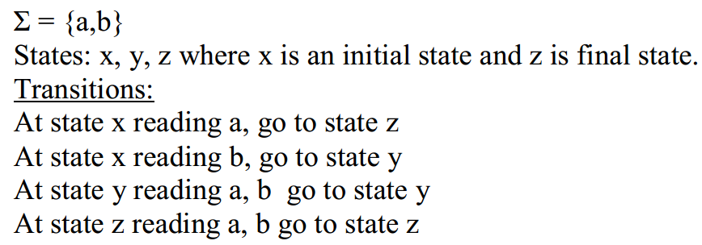
Example: (Built Transition table and transition diagram)

Slide 5
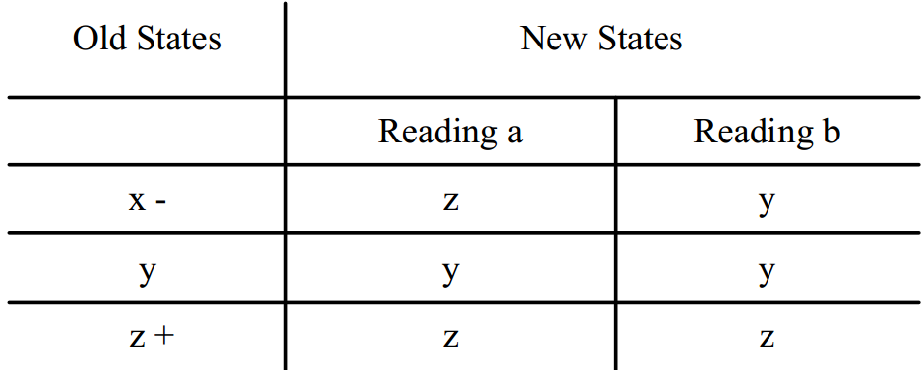
Transition Table

Slide 6
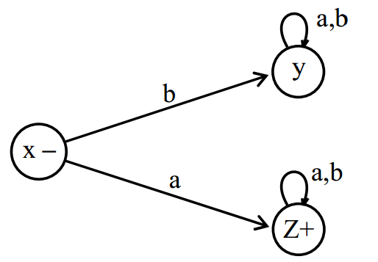
Transition Diagram
Its RE is a(a+b)*

Slide 7
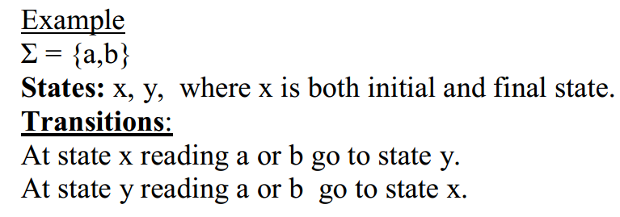
Example: (Transition table and transition diagram)

Slide 8
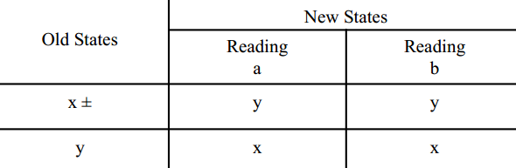
Transition Table

Slide 9
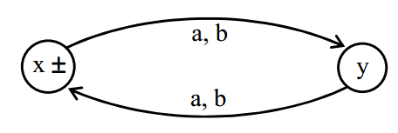
Transition Diagram
Its RE is ((a+b)(a+b))*

Slide 10
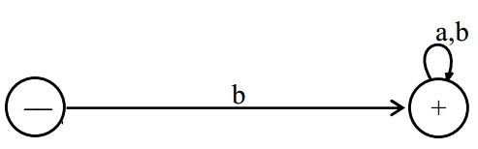
Built FA from RE starting with b

Slide 11
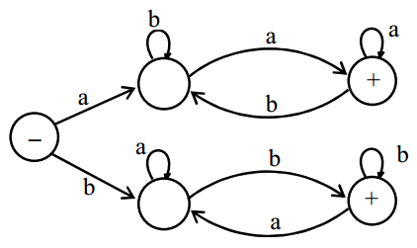
Length two or more, defined over Σ = {a, b}, beginning with and ending in same letters : FA is
Its RE is a(a + b)*a + b(a + b)*b

Slide 12
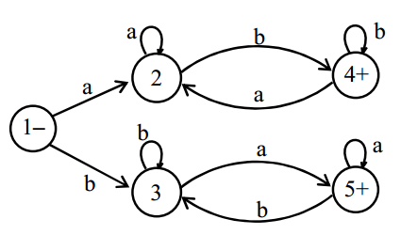
Language L of Strings, defined over Σ = {a, b}, beginning with and ending in different letters: : FA is
a(a + b)*b + b(a + b)*a

Slide 13
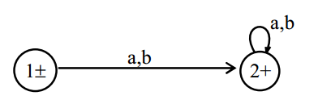

Language L, defined over Σ = {a, b} of all strings including Λ: FA is
or

Slide 14
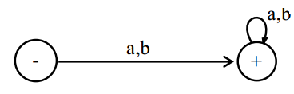
Language L , defined over Σ = {a, b} of all non empty strings
RE is (a + b)⁺

Slide 15
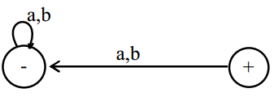
an FA defined over Σ = {a, b} that does not accept any string

Slide 16
Complement
If L is a language over an alphabet then its complement L’ is set of strings of letters from the alphabets that are not words in language

Slide 17
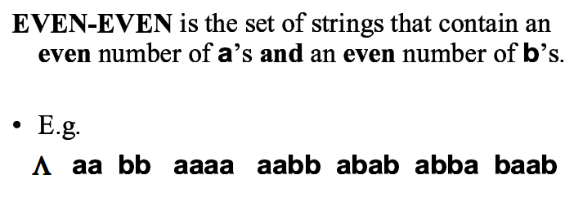
EVEN EVEN

Slide 18
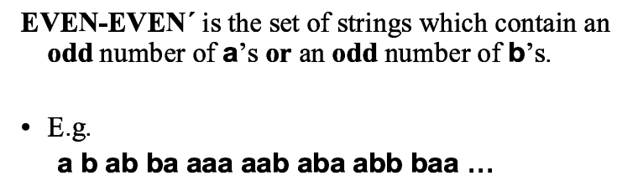
EVEN EVEN Complement

Slide 19
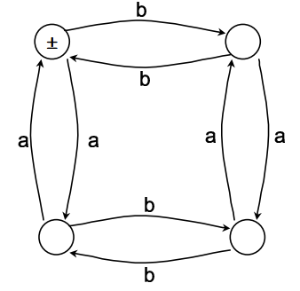
FA of EVEN EVEN

Slide 20
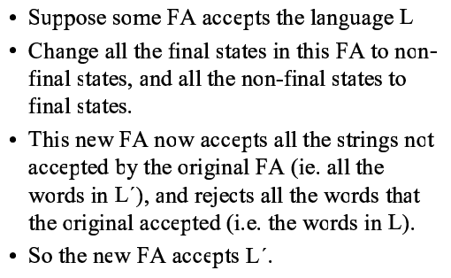
Complement FA

Slide 21
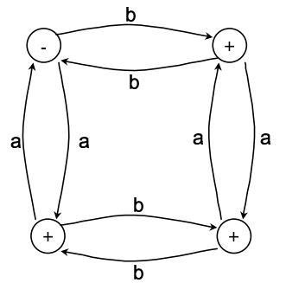
FA of EVEN EVEN Complement

Slide 22
NFA
The nondeterministic finite automaton is a variant of finite automaton with two characteristics:
Є -transition: state transition can be made without reading a symbol;
Nondeterminism: zero or more than one possible value may exist for state transition.

Slide 23
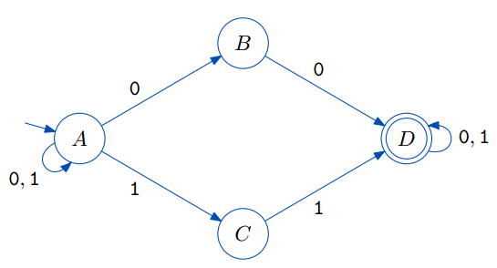
Example
It accepts any binary string that contains 00 or 11 as a substring.

Slide 24
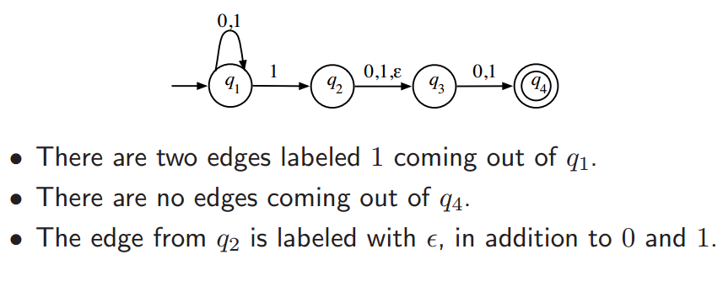
NFA Example

Slide 25
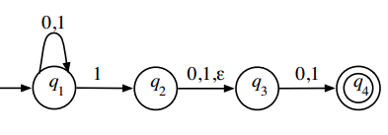
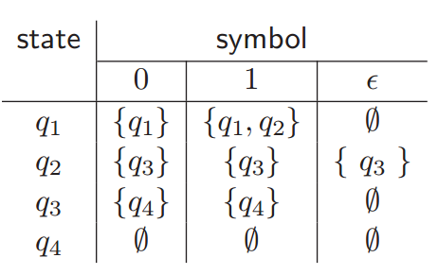
NFA Transition Function

Slide 26
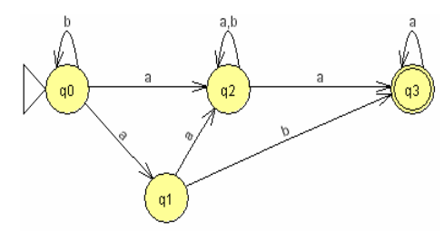
Convert the following NFA into DFA
Notes:
State merging and empty transition removal

Slide 27
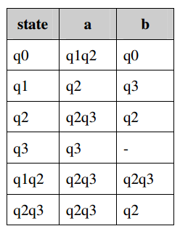
Convert the following NFA into DFA
Notes:
Note: q1q2 and q2q3 states are taken from the resultant values by reading a or b
For q1q2, read a and note the state, also read b and note the state, merge these two resultant states also against q1q2

Slide 28
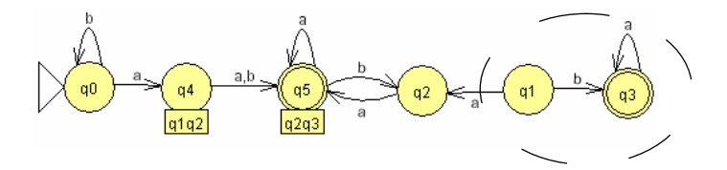
Convert the following NFA into DFA
Notes:
Add loop at q2 reading b

Slide 29
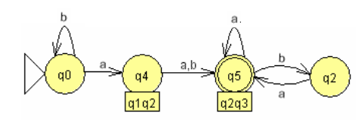
Convert the following NFA into DFA
3) Remove unreachable states (marked by dashed circle – state q1 and state q3 ) because we cannot reach it

